Slide 1

Do dogs of the same breed play football together?

Slide 2
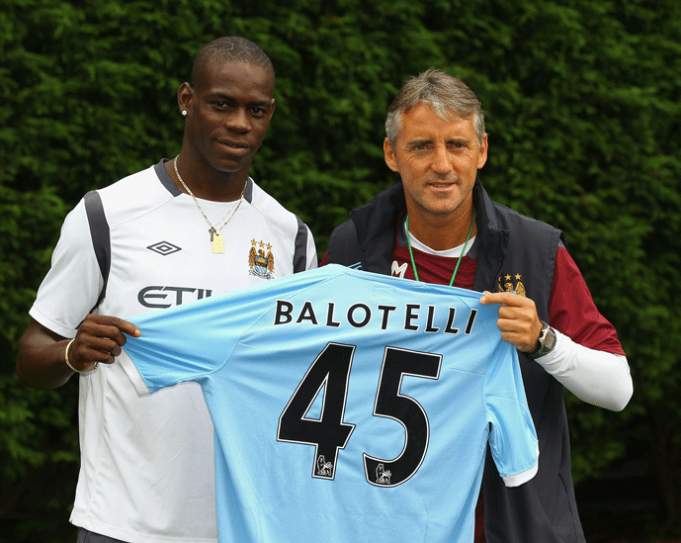
Problem Statement
Homophily
Manager and Player share same Nationality.
Choice
Transfer Decision stemming from same nationality.
Performance
Average Points per game (pg) and Expected performance (Fee) compared with Minutes Played and Goals.

Slide 3
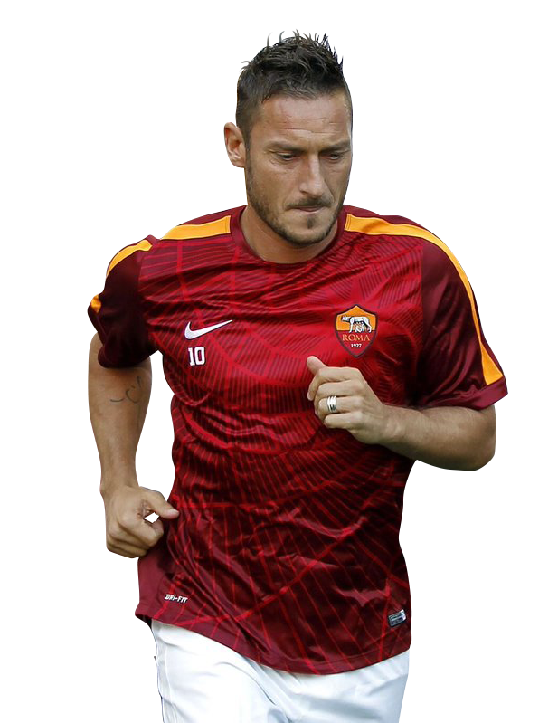
Dataset Used
Transfermarket.de
English premier league In and out transfers from 1996-2020
Statbunker.com
Manager Nationality, Average points, Tenure and Club
Wikipedia.com
Player nationalities and minutes played
G – Goals
MP - Minutes Played
Cl – Champions league
Ppg – Points per game

Slide 4
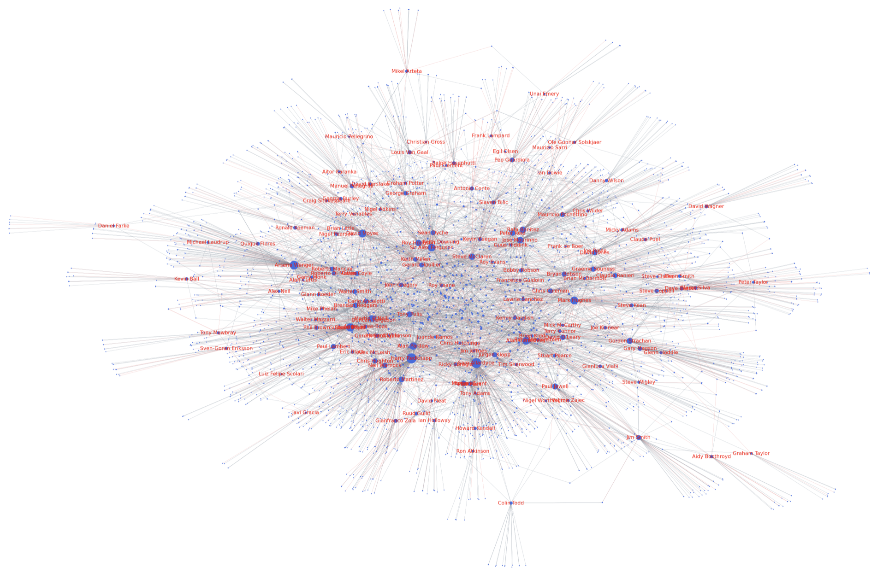
To what extent is homophily present in the network dataset at hand?
Edge color Represents matching nationality between player and manager.
Node size represents degree centrality to represent the the amount of In and Out Transfers of each manager.

Slide 5
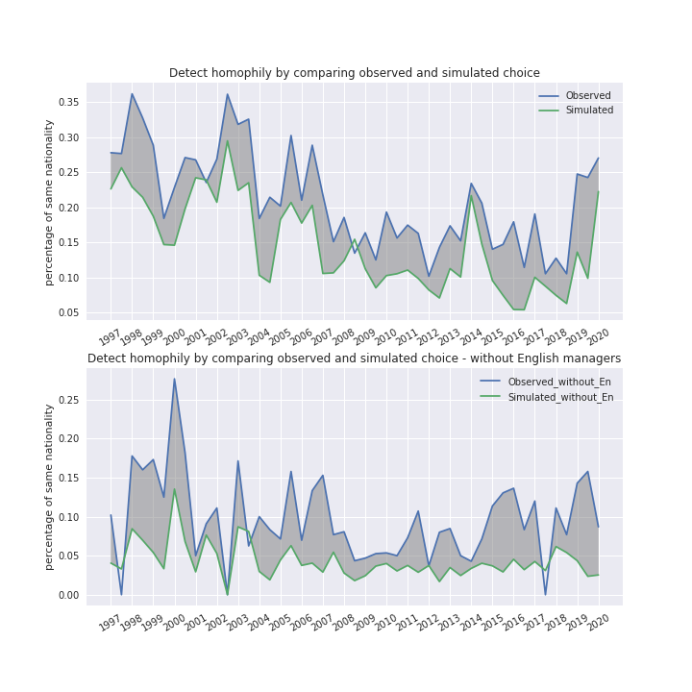
Simulation Results
Comparison of observed and simulated value of Homophily (Figure 2).
% of players that have the same nationality as their Manager based on transfer period.
Robustness Test (Notebook):
- T- Test
Chi squared
Figure: 2
Explored homophily by disregarding all English players to eliminate the geographical effect (Figure 3).
Homophily still present but to lesser extent as most managers and players are English.
Figure: 3

Slide 6
Periodical Homophily measures of each Premier League Club
Homophily measures taken from observed periodical value that managers pick players from the same nationality.
Figure 4 shows each clubs managers over the last 24 years with their respective homophily measures.
Each scatter represents a year.
Clubs with no plot for a particular year were relegated.
Figure: 4

Slide 7




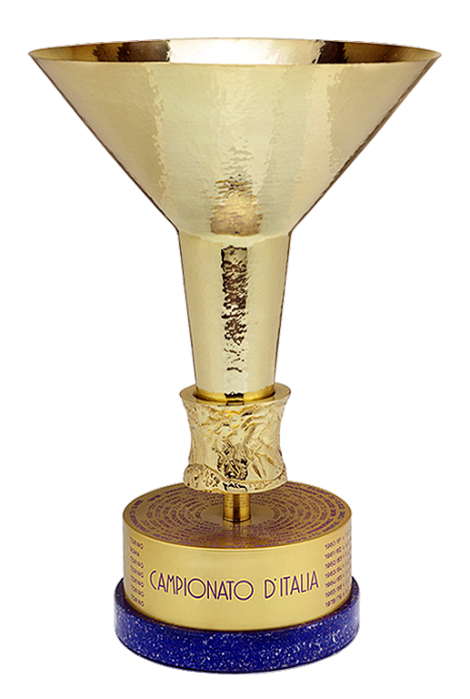
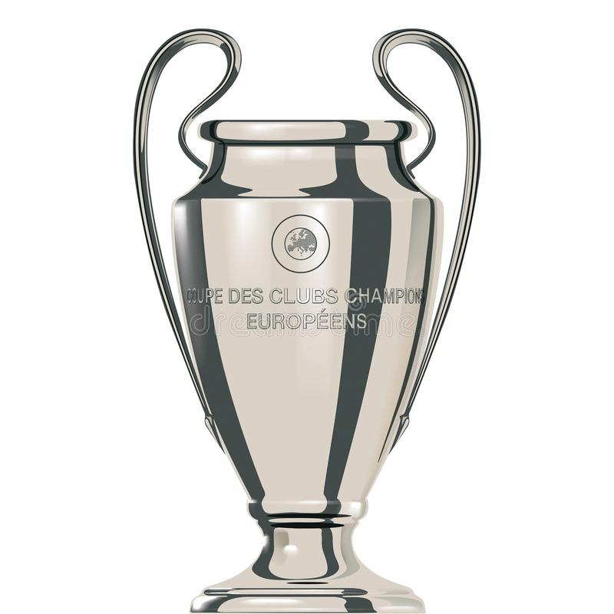

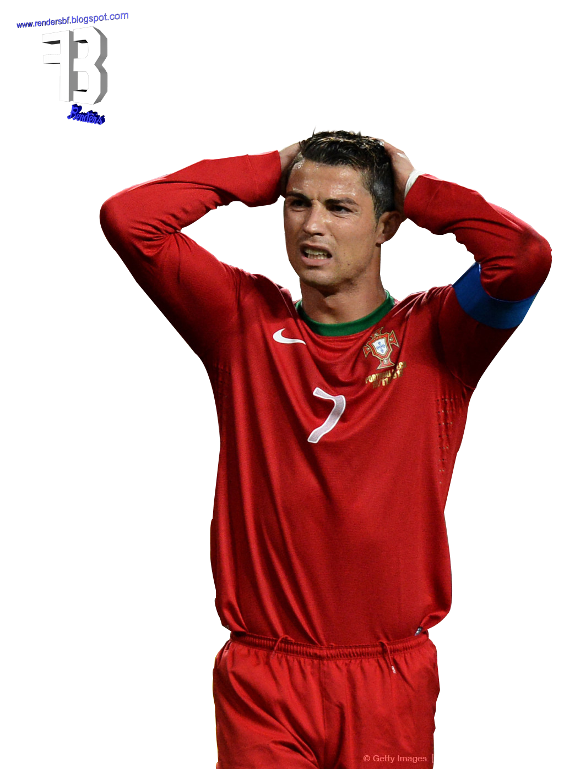
Managers to Analyze
Managers were divided into Champions league (CL) and non-CL clubs to assess the impact of buying power on homophily
From Figure 4, five managers with high, medium and low homophily measures were chosen from each strength category to analyse the impact on performance
 | Club | Manager | Homophily | Year
CL | Arsenal FC | Unai Emery | 0.5 | 2018- 2019
CL | Arsenal FC | Arsene Wenger | 0.23 | 1999- 2017
CL | Manchester City | Pep Guardiola | 0.21 | 2016 -Present
CL | Manchester United | Alex Ferguson | 0.04 | 1997- 2015
CL | Liverpool FC | Jurgen Klopp | 0.02 | 2016- Present
No | Sean Dyche | Burnley FC | 0.67 | 2017- Present
No | Nunu Espirito Santo | Wolverhampton Wonderers | 0.65 | 2019- Present
No | John Gregory | Aston Villa | 0.48 | 1998- 2002
No | Sam Allardyce | Bolton, Newcastle, West Ham, Crystal Palace, Everton, Sunderland | 0.27 | 1999- 2007
No | Martin O’ Neil | Leicester, Aston Villa | 0.03 | 2006- 2010
Figure: 5

Slide 8


How does homophily relate to an entities Performance?

Slide 9
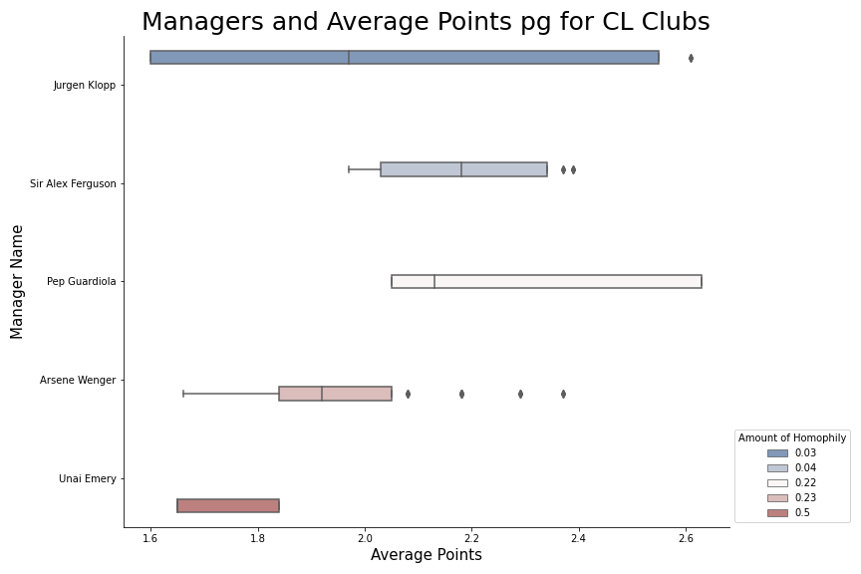
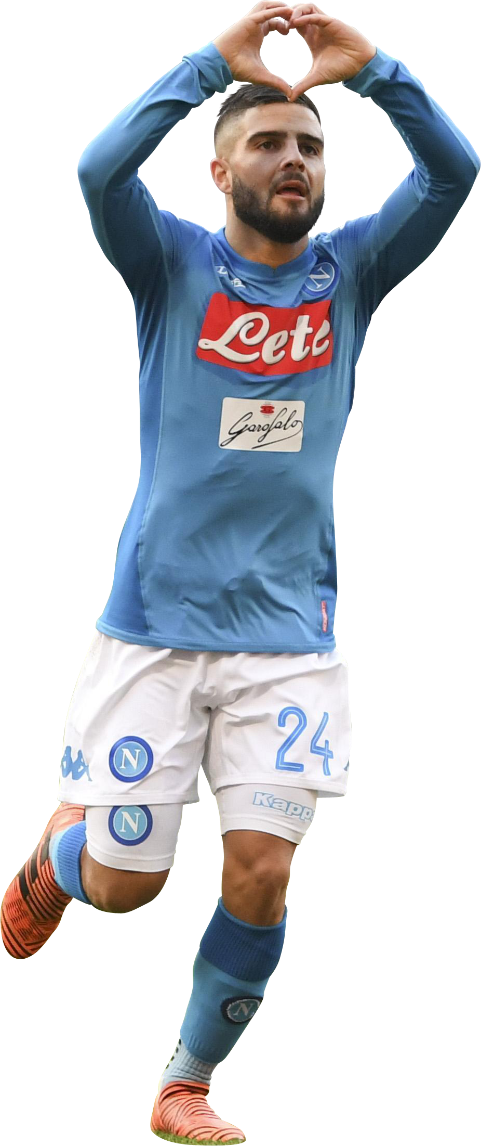
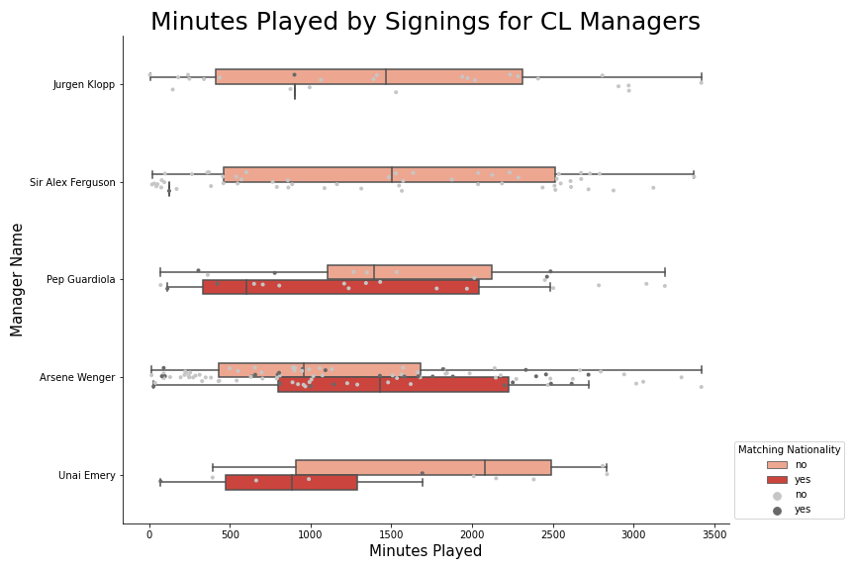
Comparison of CL Clubs
Taking the median ppg, bar Klopp, managers with low homophily measures outperformed other managers.
Figure 7 shows the median minutes played by new signings is less the more homophily the manager expresses.
Unai Emery’s signings that match only play 900 minutes on average which correlates with his low average ppg.
Although Pep Guardiola’s signings only played 600 minutes on average his avg ppg are still high.
This is due to his buying power which allows for player signings that don’t perform (Figure 10).
Figure: 6
Figure: 7

Slide 10
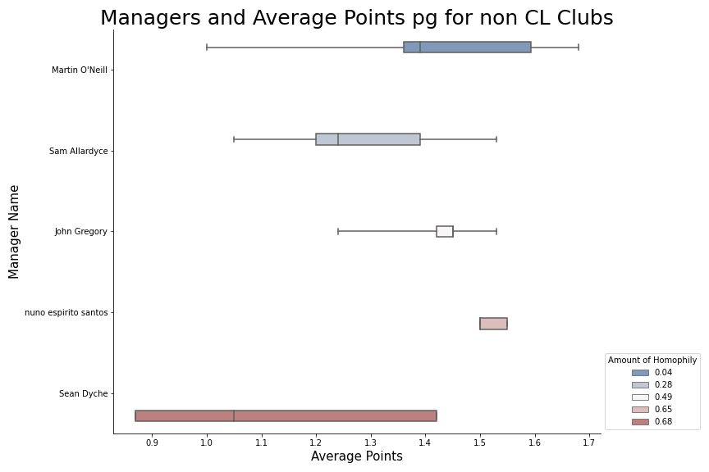
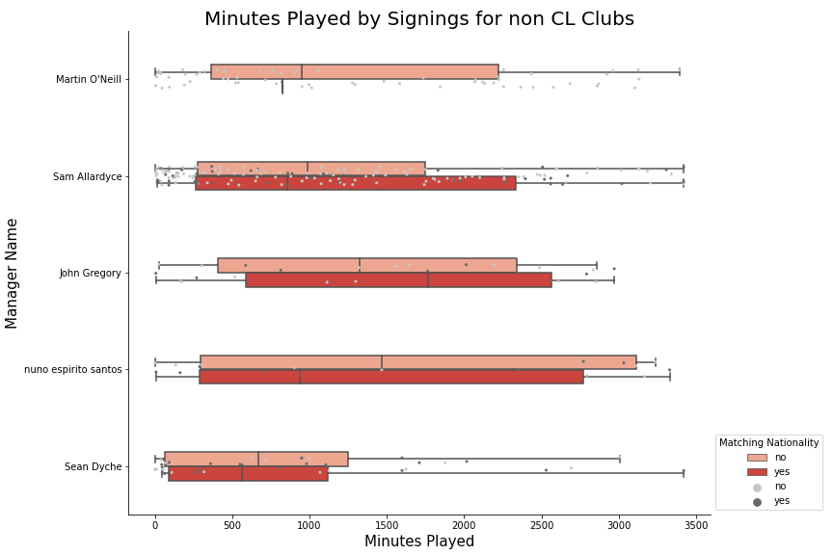
Comparison of Non- CL Clubs
Compared to CL clubs the correlation between average points and relative homophily becomes less evident.
Nuno Espirito Santo and John Gregory have managed to stay competitive despite homophily measures.
Sean Dyche has highest measure of homophily measure and low ppg (1.05)
Figure: 8
Also reflected in the MP by the new signings as values are closer to those of players that don’t match.
John Gregory’s signings were the only ones that were able to outperform those that didn’t match.
Figure: 9

Slide 11
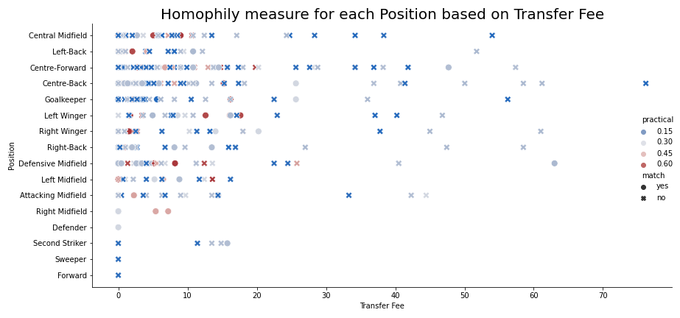
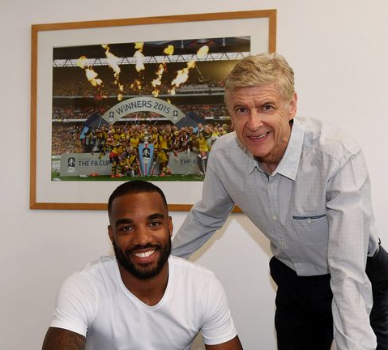
Position fee cleaned and homophily
Managers spend more for right midfielders, second strikers, wingers, Midfielders and Centre forwards that match the nationality.
Attackers are the most important positions in football a manager may trust a player of the same nationality more hence spends more by making him a priority signing.
Figure: 10

Slide 12
Conclusion
Year | Manager | Manager Homophily | Fee Paid | Player Name | Position | MP | Goals
2019 | Pep Guardiola | 0.23 | 63 | Rodrigo | Midfield | 2486.0 | 3
2018 | Unai Emery | 0.5 | 22.5 | Lucas Perez | Centre foreword | 475 | 1
2017 | Arsene Wenger | 0.21 | 47.5 | Alexander Lacazette | Centre foreword | 2202.0 | 14
2016 | Pep Guardiola | 0.33 | 16.5 | Nolito | Left Winger | 778 | 4
2012 | Arsene Wenger | 0.24 | 10.8 | Oliver Giroud | Centre foreword | 2333 | 11
2010 | Sam Allerdyce | 0.4 | 15 | Andy Carrol | Centre foreword | 1091 | 2
2019 | Nuno Espirito Santo | 0.65 | 17.63 | Daniel Podence | Left Winger | 289 | 4
Overall, it was found that both a players and managers performance are negatively correlated with higher homophily measures.
The extent to which homophily is present differs based on the strength of the team but the effects are similar for both.
Lower placed team managers experience more homophily.
Figure: 11
Figure 11 shows specific players who were affected by homophily and their performances compared to what is expected from them (Fee).
For example, Lacazette was bought for 47.5 million pounds and played 2202 minutes but only managed to score 14 goals meaning he did not perform very well.
This is reflected in Figure 6, specifically Arsene Wenger as although MP is high the average ppg is low.

